Slide 1

ITF: Developing strategic campaigns Campaign tools
LEAFLETS
Notes:
Objectives:
Understand campaign leaflets and how they can be used
Review the format and what goes into a leaflet
Understand how to make a leaflet hard hitting
Create a campaign leaflet
Materials:
Copies of the activity slide and copies of sample leaflets
Notes: We will be learning about hard hitting leaflets to have maximum impact on a target, not informational or educational leaflets.

Slide 2
What goes into a leaflet?
Attention grabbing headline
Graphic
Short description of the problem and link to the demand of the direct target (150 words)
Name of union or coalition
May include legal disclaimer
Draw the reader to the strongest part of your message
Everything
must be accurate and legal
Notes:
We are talking about a specific type of leaflet in this module - leaflets which pressure a specific target, not educational or informational leaflets.

Slide 3
Why use leaflets?
Low cost, high impact
Challenge the public image, product, price
or service of the target
Focus public outrage in a meaningful way

Slide 4
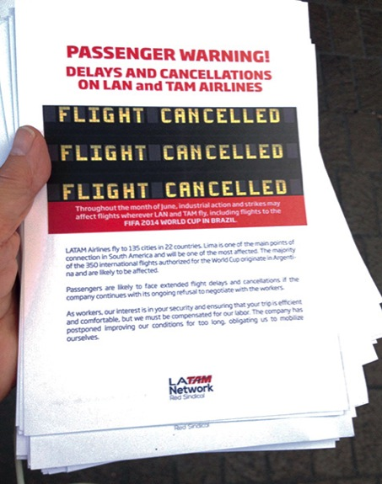
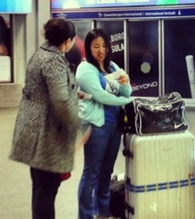
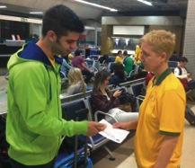
Passenger leaflet
Notes:
These leaflets were distributed in airports throughout South America and at a tennis match in Miami which was sponsored by LAN Airlines.
They could also have been handed out at any large event or convention with an audience that might fly LAN or TAM airlines in the future.

Slide 5

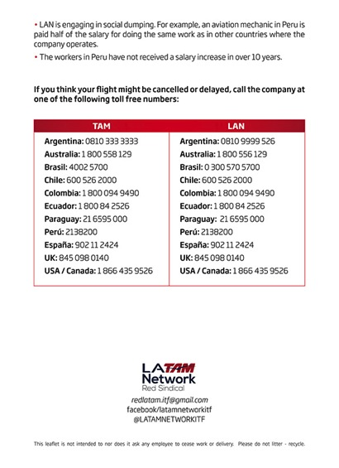
Notes:
Ask participants to identify these sections of the sample leaflets:
Headline
Graphic
Description of the problem
Link with the direct target
Name of the union or coalition
Legal disclaimer (if used)

Slide 6

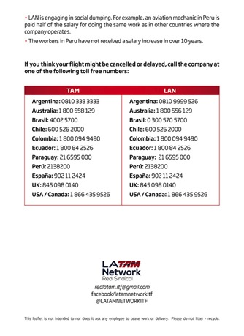
Demands of direct target
Headline
Graphic
Description of problem
Union
Legal disclaimer

Slide 7
Do not include the target’s contacts
It will be a sign of weakness if only a few phone calls
or emails are received.
Notes:
One exception was the LAN Peru leaflet, because the passengers were already calling the company about delays due to the urgency of the situation.
If you do want to use the target’s contact details, organise a large number of calls or emails at the time of the leafleting.

Slide 8
Creating a leaflet
Focus on a specific target
How can you raise questions about what the company/entity cares about the most?
    Image
    Service
    Price
    Quality
    Safety
    Delays

Slide 9
You might ask a question
  “What has gone wrong at __________?”
  “Could your flight be delayed?”
  “Is it too high a price to pay at _________?”
Look for what might concern someone from wanting to use the target’s product or service
Notes:
Everything you say must be accurate and legal. If you are not sure, see if you can ask a question, rather than state a fact.
“What has gone wrong at ______________?” can be used in many different campaigns.
“Could your flight be delayed?” or “Is it too high a price to pay?” are more specific questions.

Slide 10
Shareholder meeting leaflet DHL Turkey
Headline
Description
of problem
Graphic
Demand of target
Union
Notes:
This leaflet was distributed at a DHL shareholders meeting. These were major customers, whose loss would have an impact on profits.
The question on the leaflet “Shareholders, are you concerned that DHL’s treatment of workers in Turkey is compromising its global business?” is the demand to the direct target. The leaflet is stating that DHL Turkey needs to treat workers better.
Think about where a different leaflet could be used in this campaign. Who might the target audience be and what large events could you leaflet?
Some possible headlines could be “What is wrong at Ikea?”; “Is it too high a price to pay for Adidas?”; “What is wrong with the quality at Ikea?”
You would need to include a statement showing the link to the direct target, such as “Adidas, are you concerned that DHL’s treatment of workers in Turkey is compromising your business?” or, “Is it any wonder that with high prices at IKEA furniture store, they also use DHL delivery service, where workers in Turkey are treated unfairly.”

Slide 11
Leaflets might include
    Consumer reports or reviews
    Governmental and regulatory agencies
    Company’s own research
    Surveys of customers
    Parody company’s own advertising or election campaign
    Comparison to competitors
Notes:
The company may have made public commitments to customers or have core business principles which you could include.

Slide 12


DHL leaflet
London Fashion Week
Headline
Graphic
Description
of problem
Demand of target
Union
Notes:
Video of DHL protest at London Fashion Week: https://www.youtube.com/watch?v=F_rTygJwQgQ

Slide 13

TWU leaflet
Graphic
Headline
Description
of problem
Demand of target
Union
Notes:
In Australia, TWU, the union for truck drivers has been campaigning for “safe rates” for drivers. They have targeted large trucking customers, focusing on Coles supermarket chain.
The union determined that Coles’ growth plans were based on being able to redevelop a large number of local stores into regional hubs in a short time frame.
The union went to the local community about a proposal for a new Coles store. The truck drivers were concerned that despite a massive increase in freight, there was no planned increase in loading docks – forcing them to idle on suburban streets. Local residents were angry that the redevelopment would see the destruction of a 125-year old cork tree (one of only a handful world-wide).
The union worked with the local residents’ association to coordinate materials, media conferences and actions at the local council. The leaflet was used during door knocking by union members and the residents' association to increase turnout. The council rejected the application.

Slide 14
No more than 150 words
Use graphics, questions and headlines to get attention
Factsheets provide background information

Slide 15
Indirect targets
Focus your tactics on the indirect target.
Include your campaign goals and the name of the direct target to avoid confusion.
Link indirect target to demand of target
Indirect target: Grocery store with High Prices
Direct target: International Trucking Co.
Large letters / banners: HIGH PRICES at Apples Grocery Store
Small letters: We are here today protesting high prices. In addition to high prices Apples Grocery Store uses International Trucking Co. that makes drivers work long hours, creating fatigue and unsafe road conditions in our community.
Notes:
This slide may be familiar from the PowerPoint module on Tactics.
When writing a leaflet for an indirect target, make sure that both your central campaign goals and the name of the direct target is always clearly communicated. Otherwise, your allies, the public, and even the indirect target could become confused about who the action is directed against.
If you are leafleting a grocery store, have your leaflet focus customer attention on what will pressure the grocery store the most (high prices, poor quality of product). Include, perhaps in smaller print, the name of your direct target and your campaign goals.
You may want to communicate with indirect targets before you take action. In the example above, you could show your leaflet to the Apples grocery store company ahead of time, perhaps offering them an opportunity to support the campaign by signing the demands to the International Trucking Co., or committing to discuss the issue with the International Trucking Co.

Slide 16
Legal review
  Always do a legal check of every leaflet
  In many countries, informational leafleting of indirect targets has more legal protection than picketing
  Sample legal disclaimer:
  “This is a consumer awareness leaflet. It is not intended to ask workers to cease work or prevent the delivery of goods.”
Notes:
In countries where there may be some legal concern that leafleting might be confused with the picketing or work stoppages of a secondary target, the sample legal disclaimer may be helpful.

Slide 17
Look for large public events
  Opportunities to leaflet, disrupt or engage your target:
    Sporting or cultural events
    Markets / shopping centres
    Industry trade shows
    Company events
    Large groups of potential customers or service users
    Shareholders meetings
    Airports or transport hubs
Notes:
Participants may remember this slide from the research module.

Slide 18
Activity: Creating a campaign leaflet
Aim: To create an outline for a campaign leaflet
Tasks: Select a facilitator and timekeeper
Choose a direct or indirect target and leafleting location.
Follow the format:
Attention grabbing headline
Graphic
Short description of the problem and link to the direct target (150 words)
Name of union or coalition
Legal disclaimer, if needed

