Slide 3
ITF Youth - Outline of the presentation
Delivering Congress outcomes
ITF Youth Committee Meeting 2019

Slide 4
ITF Youth - Delivering Congress outcomes
ITF 2018 Congress Resolution (20)
Promote all affiliates to create youth structures in order to increase young transport workers activities.
Liaison with its affiliates to support young transport workers in organising activities and focusing on organising the young transport workers in all the affiliated unions in a more structured manner.
Continue to map membership statistics in terms of young transport workers members and grow the global young transport workers network.
Ensure the crucial link between the work taking place through ITF headquarters with the regional priority work and supporting young transport workers' involvement regionally.

Slide 5
ITF Youth - Delivering Congress outcomes
Focus:
Gig economy
Aviation
Informal workers
Digital skills and tools

Slide 6
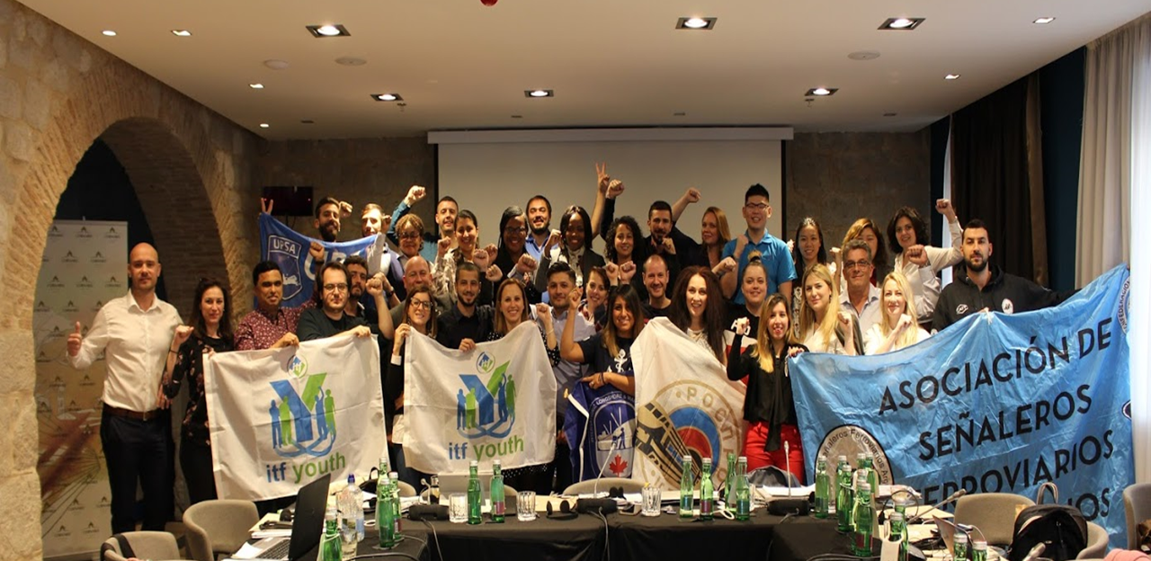
ITF Youth Committee Meeting 2019

Slide 7
2019 YTW Committee meeting outcomes
Growing and activating membership/Innovating Campaigning
Training and capacity building:
Organising and mentoring skills/strategies
Future of Work
SDGs
Wellbeing
Cadets
Digital skills
Develop digital tools for organising to activate and strengthen networks of young
Train YTW organisers and mentors on digital skills

Slide 8
2019 YTW Committee meeting outcomes
Growing and activating membership/Innovating Campaigning
Informal work:
Organise young workers in informal urban transport
Improve unions’ capacity to organise informal workers
Campaign to increase visibility of young workers in informal work
Gig Economy:
Research and Mapping
Build a structured network of food delivery riders
Build affiliate knowledge and skills for organising gig economy workers

Slide 9
2019 YTW Committee meeting outcomes
Growing and activating membership/Innovating Campaigning
Job transition-Automation
Policy collaboration with the NTUC
Research on employment landscape and job opportunities
Secure the upskilling and reskilling of young workers to facilitate their transition to appropriate/higher value jobs
Low Cost Carriers
Build organising and campaigning capacity of young workers to organise and engage in LCC campaigns

Slide 10
2019 YTW Committee meeting outcomes
Influencing global and regional policy
Promote the informal transport workers charter in the ITF people’s public transport policy.
Raise awareness on the relation between climate change and jobs to support the OPT campaign with PSI and ITUC on Just Transition, climate jobs and public services.
Strengthen collaboration with affiliates and other GUFs to address young workers’ issues related to future of work and the ILO C122 on employment policy.

Slide 11
YTW Committee meeting outcomes:
Other activities
Other Activities
Summer school
Communications
International Youth Day
Apprenticeship programme for affiliated YTW
Solidarity

Slide 12
