Slide 1

ITF: Developing strategic campaigns Module Two
ARBOLITOS
(worker networks)
Notes:
Objectives:
Identify and discuss the different types of communications which unions use with workers.
Discuss how “arbolitos” (worker networks) are used in campaigns.
Create a specific plan on how you can use arbolitos in your campaign.
Fill out the ‘Campaign Summary Form’ section on arbolitos.
Materials: Copies of the “Campaign Summary Form” and the activity sheets.
Notes:
You will need copies of the “Campaign Summary Form” as participants will be filling out the section of arbolitos.
For a more in depth discussion on arbolitos, refer to the ITF Organising Manual.
Materials: flip chart paper, markers, copies of the activity sheet
Notes:
Be prepared to give participants time to research, or provide a research report for participants to review. For assistance in creating a research report, go to the section on “Research.”
It is very important that adequate information about the employer’s relationships (and the relationships of the relationships) is obtained prior to this and other modules. Good campaigns are built on detailed and accurate information, not generalities.
We will refer back to the participant's diagram of employer relationships as we move forward, particularly when we get to the PowerPoint module on “Targets and allies”

Slide 2
Which of these groups are the largest in your unions?
Workers who are actively involved in the union?
Uninvolved workers?
3. Workers who are anti-union?
Notes:
Ask each participant to think about a worksite or a group of employees you know well.
If the participants say the largest group is the middle group, they will be similar to other unions throughout the world.
Sometimes in particularly strong unions or during a particular campaign or strike the involved employees will be largest. In an unorganized workplace the anti- union employees may be largest.
The group of uninvolved employees is usually the largest untapped resource of the union.
Discussion Questions
Ask participants to think about where we as leaders spend our time. Leaders are one of the most valuable resources of a union. Is our time spent with the involved employees or is it with the uninvolved members? And do we spend too much time and energy worrying about the anti-union group?
Ask participants identify the different types of entities with whom the employer has relationships and add them to the diagram.

Slide 3
List the different types of communication the union uses with workers
Which one do we use the most?
Which allows the most feedback?
Which is best when workers are afraid
or uninvolved?
Notes:
Ask participants to list the different types of communication: Newsletters and leaflets, websites, telephone calls, email messages, text messaging, social networking, meetings, person-to-person contact, media (eg, television, radio, newspaper)
Which do we use the most? Participants will probably choose a written form of communication.
Which allows the most feedback from workers? Participants will probably choose person-to-person.
Which is best when workers are afraid or lack knowledge about unions? They will probably choose person-to-person.
Discussion Question:
Why do we not use more person-to-person and one-to-one communication?
It is often seen as too time-consuming. One reason we rely on written communication is that it is less resource-intensive and more efficient. As leaders we feel that we have done our job. If the workers were too busy or uninvolved to read the information, we can blame them. However, it is our responsibility to change our communication methods if the current methods are not working well.

Slide 4
Basic guidelines for arbolitos
(worker networks)
5-7 specific workers to one communicator
Person-to-person and one-to-one
Regular messages
Notes:
Person-to-person communication networks are a simple concept but also one of the most important things that we can do.
Arbolitos (or worker networks) create a more efficient way of ensuring that workers have one to one relationships with people who can keep them informed about the campaign.
5 is the number of people that one person will be able to keep in touch with regularly. If the group is larger than 7, people will probably not have regular one-to-one contact.
It is better to have a small number of functioning arbolitos than a larger number where workers are not regularly receiving information.

Slide 5
One communicator for 5 to 7 workers
Notes:
In any campaign, you will not find that arbolitos coverage as systematic and exact as in this diagram.
Instead it will be a fluid, sometimes chaotic, ever changing network of communications, and it may be small with a very small number of workers involved.

Slide 6
Why do we call worker networks “arbolitos” (little trees)?
Notes:
Trees start small and grow
There are a lot of branches
Gardening needs a lot of time and patience
Constant pruning is important
Sometimes there are more leaves, sometimes fewer
… and ITF unions in Argentina, Chile, Colombia, Ecuador and Peru use the word.

Slide 7
Arbolitos support union structures, not replace them
Workplace delegates and leaders recruit, train and support the arbolitos
Arbolitos can assist delegates
Notes:
It is often easier to ask people to get involved in communicating with their coworkers than it is to ask them to stand up to the boss. Often the arbolitos communicators eventually become new workplace delegates and union leaders.
Think about whether your campaign can help improve or expand the union’s networks of workplace delegates. You might want to organise educational and training events or more fully utilize your union membership meetings. The “ITF Organising Manual” will provide you with instructions, ideas and support in all of these areas.

Slide 8
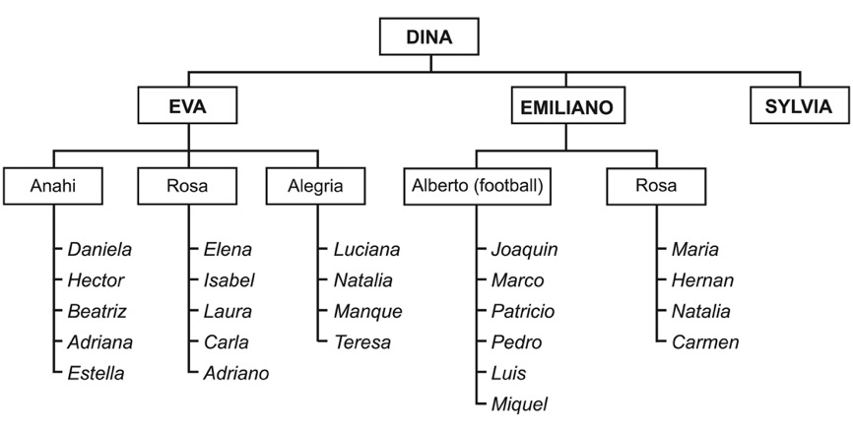
Example
Goal: 70 people talking to 350 flight attendants
Notes:
This is an example of the beginning of an arbolito (worker network) working to organise airline flight attendants.
Some of the members of this network are non-union flight attendants, some of them are flight attendants working for another unionised airline, and some of them used to work for the non-union company and want to help organise.
Alberto is responsible for organising football and Facebook events as well as talking to four people.
Rosa is responsible for keeping in communication with five people – Elena, Isabel, Laura, Carla and Adriano.
Dina is responsible for talking to seven people, and Emiliano is responsible for talking to two people.
Sylvia is not responsible for talking to anyone, but she is an important person for Dina to be in contact with.
Eventually, the organisers put their list on an Excel spreadsheet to work with it more easily.

Slide 9
Start small
1-3 branches is a good start
Allocate time for constant updating
Keep active or they will fall apart and be more difficult to rebuild

Slide 10
Under-represented groups
List workers who are under-represented in the union (by age, work location or area, shift, type of work, language, culture, race, gender etc)
Workers can communicate about the union in their own languages and cultures

Slide 11
We can sort workers for arbolitos by:
Home address or postcode
Work areas or shifts
Who knows whom
Transport to and from work
Other…

Slide 12
Accountability and support
Regular reports from all
Spot checks
Notes:
Reports from the communicators might include the number of workers who have been spoken to and what they are saying.
Check with the people inside the arbolitos groups and see if they are getting the information. If not, discuss this with the arbolito leader and decide what changes might need to be made.

Slide 13
Support worker solidarity
To build power in a large campaign look to support the workers who are best prepared to withstand company pressure.
Notes:
The most common reason large campaigns fail is because workers on the ground are not able to withstand the increasing pressures from the employer as the campaign progresses. This principle is clearly demonstrated in both the case study of the LAN Peru mechanics and the workers at DHL Turkey. Without the solidarity, strength and unity of the workers on the ground, both campaigns would have been failures.

Slide 14
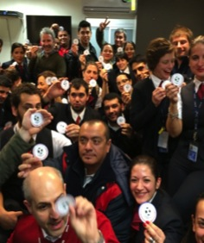
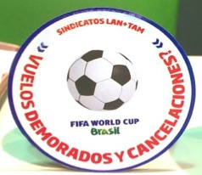
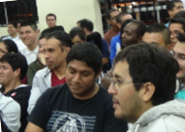
Arbolitos (worker networks)
2 years organising unity of workers
Talked to all workers daily by shifts
  to lessen fear
  educate about rights
  develop deep relationships
Notes:
See the manual for a more detailed explanation of how the union built the base despite intense pressure from the employer.
Ask participants what level of worker support they will need to withstand employer pressure.

Slide 15
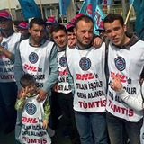
Arbolitos (communication networks)
Initial contacts:
  TUMTIS members contacted DHL
  workers.
  Approached workers as they came
  and went to work.
  Daily systematic 1 to 1 conversations
  with workers and families.
Information sessions at local cafes.
Picket of fired workers in front of workplace.
When offered bribes to join the company union the workers refused.
When ready, workers joined TUMTIS en mass.
2,200 workers
33% subcontracted
Notes:
TUMTIS members contacted DHL workers. They approached workers as they came and went to work. From the beginning there were daily systematic one to one conversations with workers and their families. This was led by 300 TUMTIS workplace delegates from union workplaces, including UPS. In addition, 20 TUMTIS staff organisers worked on the campaign in addition to their other duties.
The picket line of the fired workers was set up in front of the company, early on in the dispute. This allowed for additional conversations between the current workers, the fired workers and TUMTIS leaders. The company tried to prevent workers from going near the picket line during their lunch breaks.
TUMTIS leaders visited the workplace daily. They spoke to workers before work started, at lunch breaks and after work. Informational sessions were held at cafes close to the workplace.
The company began to offer bribes for workers to join the company (yellow) union. The workers refused. This built the strength of the union.
Press statements from the union supported the growing unity of the workers publicized the situation of the fired workers. When the workers had built their strength and it was time to go to the labour ministry to petition for recognition of TUMTIS, the workers joined TUMTIS en mass.

Slide 16
Activity: planning arbolitos
(worker networks)
Aim: To plan how arbolitos (worker networks) will be used in your organising
Tasks: Select a facilitator and timekeeper
Describe the workplace leadership structure of your union. How can we involve these leaders in the creation of the arbolitos?
How many communicators will we need? How many do we have now? Do we need people to be
co-ordinators?
Continues on next slide…
Notes:
Have participants fill out their Campaign Summary Form section on arbolitos by writing down the 1-3 initial steps they plan to take to set up or strengthen their arbolitos.
If arbolitos do not fit their campaign needs, they should fill in 1-3 other steps that they can take to strengthen worker involvement.

Slide 17
Activity: planning arbolitos
(worker networks) continued
How will we recruit, train and support these people?
What information will we need to collect, and how will we keep and maintain records?
What problems might arise? How will we overcome these problems?
Write down 1-3 steps you need to take to create or strengthen arbolitos for your campaign.

