Slide 1
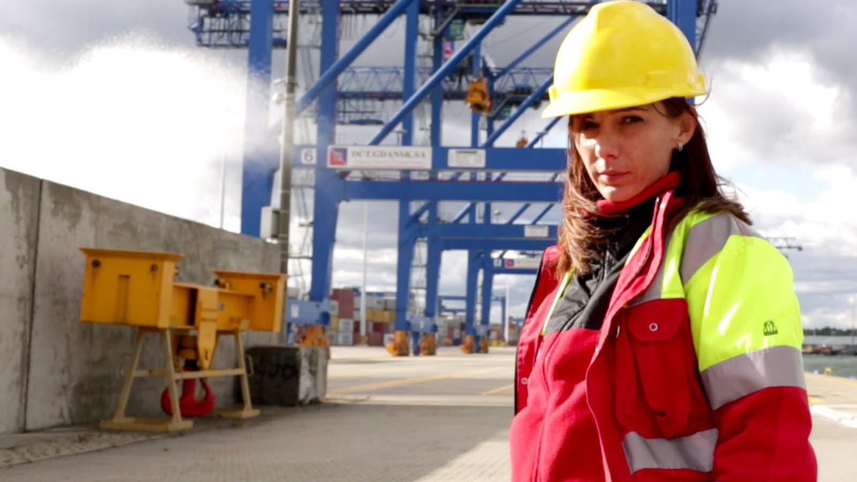
THE LABOUR
AND GENDER RELATED SAFEGUARD FRAMEWORKS
OF INTERNATIONAL FINANCIAL
INSTITUTIONS
Notes:
This presentation is for educators to introduce the topic of international financial institutions, why the topic and a gender focus is important, and how unions can engage and influence financed projects

Slide 2
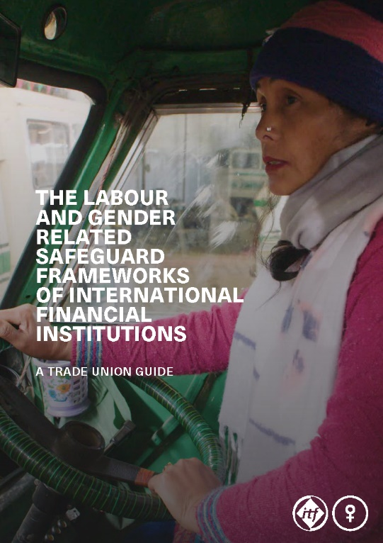
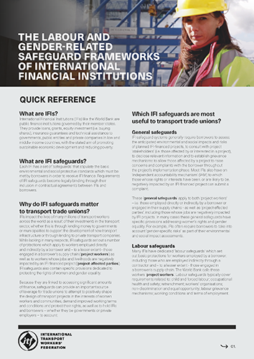
ITF TAKE ACTION TRADE UNION TOOLKIT
A trade union guide
A quick reference summary
A ‘COVID-19 and IFIs’ briefing
All toolkit resources can be found at: www.itfglobal.org
Notes:
This presentation is part of the ITF Take Action Trade Union Toolkit on the safeguard frameworks of international financial institutions (IFIs) such as the World Bank and International Finance Corporation (IFC).
The toolkit aims to act as an educational and practical resource for trade union activists to understand and strategically engage with the safeguard frameworks of IFIs, with a particular focus on how such safeguards can be utilised by unions to support women transport workers.
The toolkit consists of:
A trade union guide
A quick reference summary
A ‘COVID-19 and IFIs’ briefing
All toolkit resources can be found at: www.itfglobal.org

Slide 3
THIS PRESENTATION COVERS…
What are IFIs?
What are IFI safeguards and why do they matter to transport workers?
Why a focus on gender is important?
How can we strategically engage with IFI safeguards?
Notes:
This presentation covers:
1. What are IFIs?
2. What are IFI safeguards and why do they matter to transport workers?
3. Why a focus on gender is important?
4. How can we strategically engage with IFI safeguards?
… which will cover:
- different safeguards (labour, gender-related, etc.)
- independent accountability mechanisms
- the project cycle
- key points for union intervention
- our priorities

Slide 4
1.WHAT ARE IFIs?

Slide 5
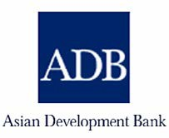
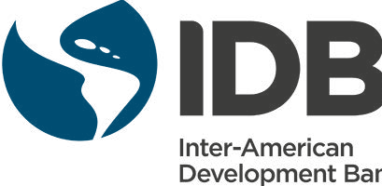
INTERNATIONAL FINANCE INSTITUTIONS (IFIs) =
public financial institutions which provide finance to governments, public entities and private companies in low and middle-income countries, with the aim of promoting sustainable economic development and reducing poverty
Notes:
So, let’s start at the very beginning – what are IFIs?
International multilateral development banks (MDBs) like the World Bank and regional multilateral development banks (RDBs) like the African Development Bank (AfDB), Asian Development Bank (ADB) and the Inter-American Development Bank (IDB) provide loans, and in some cases grants, to governments, public entities and private companies in low and middle-income countries, with the stated aim of promoting sustainable economic development and reducing poverty.
Along with the International Monetary Fund (IMF), MDBs are collectively known as international financial institutions (IFIs).
International Finance Institutions (IFIs) are public finance institutions governed by their member states. Membership sizes range from 189 states in the case of the World Bank to five states in the case of the New Development Bank (NDB).
Members of IFIs tend to be divided into borrowing (poorer) and non-borrowing (richer) countries, with non-borrowing countries having the most power over decision-making due to their larger financial contributions. Such power imbalances mean that IFIs have serious ‘democratic deficits’ and countries that are already rich and powerful are able to have the most influence over their agendas.
IFIs all work within a neo-liberal framework, i.e. to promote privatisation and increase the role of the private sector in the economy and society.

Slide 6
WORLD BANK GROUP
REGIONAL DEVELOPMENT BANKS
IFC
AfDB
ADB
IDA
WB
NATIONAL DEVELOPMENT BANKS
IDB/IADB
EBRD
IBRD
AIIB
NDB
Notes:
The World Bank is the oldest and one of the largest and most influential IFIs globally
It is composed of two organisations - the:
The International Bank for Reconstruction and Development (IBRD) which lends mostly to governments in middle-income countries; and the
International Development Association (IDA) which provides loans and grants to low-income countries
It is part of the wider World Bank Group (WBG) which also includes the:
International Finance Corporation (IFC) – the private sector lending arm providing loans, equity and technical advice to companies
MIGA – which provides political risk insurance to investors and lenders
ICSID – which provides a forum for the arbitration of disputes between investors and governments
The regional development banks were all set up during the late 1950s and early 1960s. They include the:
African Development Bank (AfDB)
Asian Development Bank (ADB)
Inter-American Development Bank (IDB or IADB)
The EBRD (European Bank for Reconstruction and Development) has a specific mandate to support the transition towards ‘market-oriented economies and the promotion of private and entrepreneurial initiatives’ in Central and Eastern Europe.
The New Development Banks include the:
Asian Infrastructure Investment Bank (AIIB) and
New Development Bank (NDB) – often referred to as the ‘BRICS’ bank due its membership

Slide 7
IFIs AND THE TRANSPORT SECTOR
IFIs finance a large number of transport development projects
across the world
They also advise governments on transport policy and provide
loans to transport companies
For these reasons they impact the lives of millions of transport workers
Notes:
IFIs finance a large number of transport development projects across the world
They also advise governments on transport policy and provide loans to transport companies
For these reasons they impact the lives of millions of transport workers

Slide 8
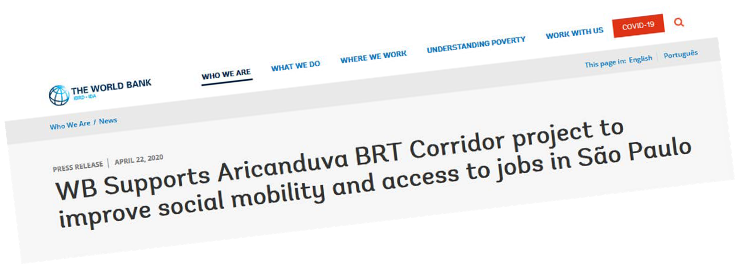
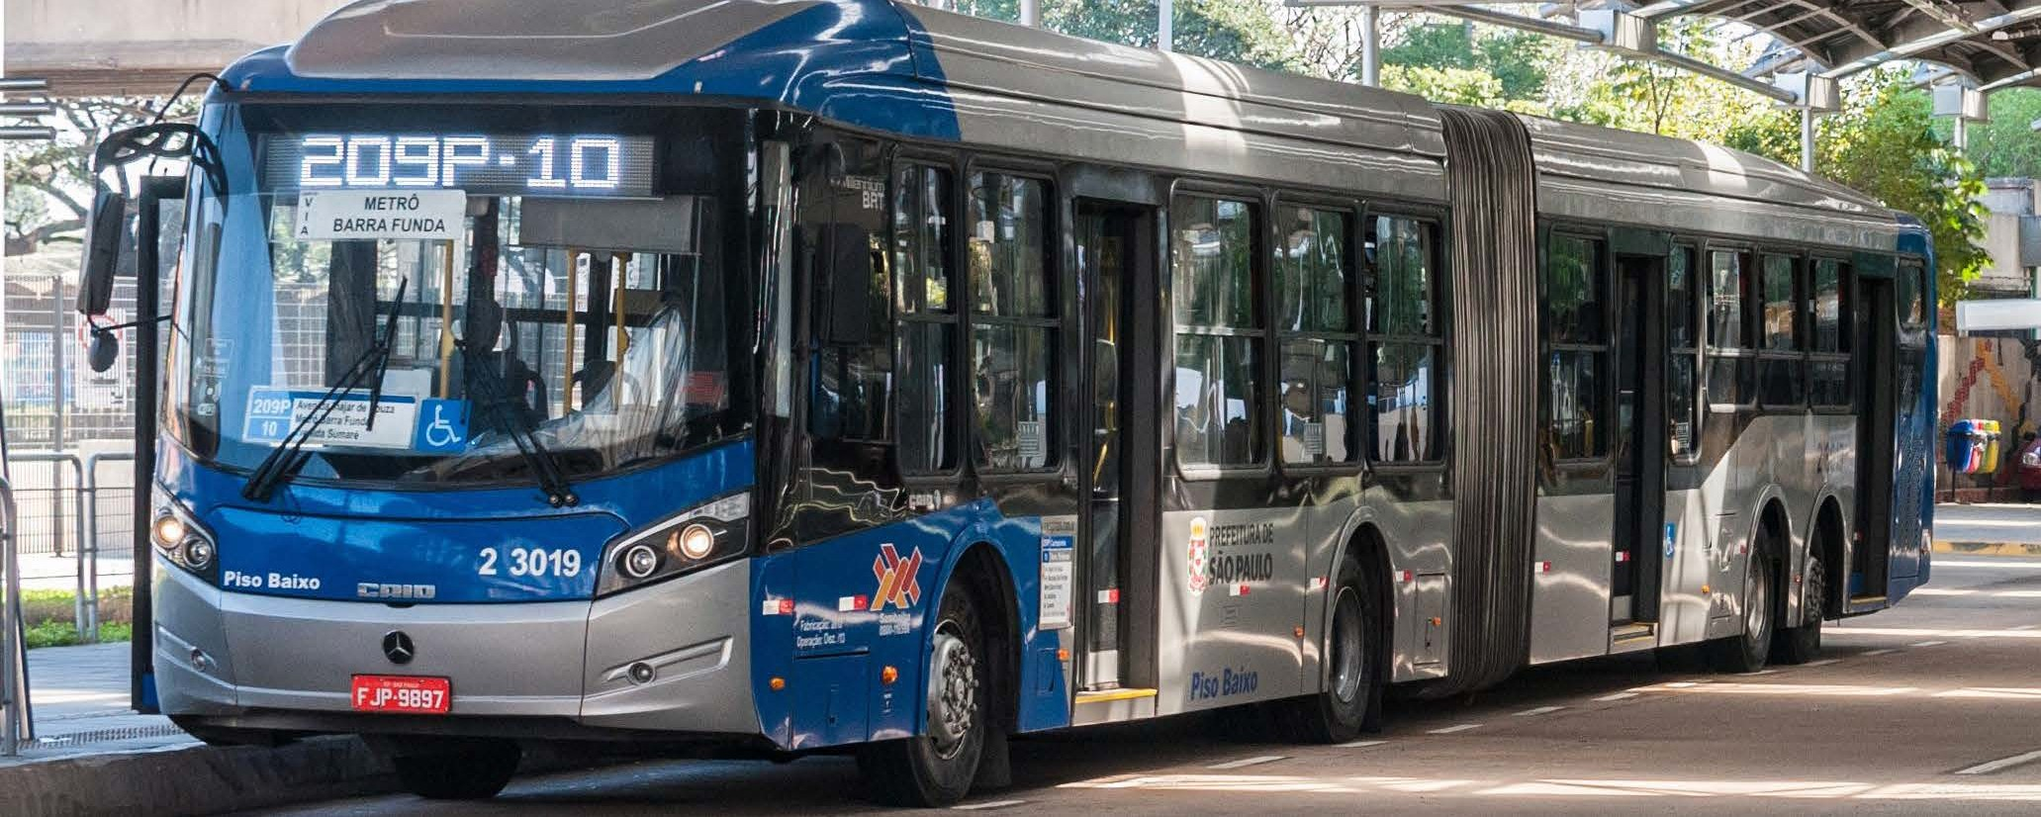
EXAMPLE: Aricanduva BRT Corridor, São Paulo, Brazil - World Bank, 2020
Notes:
Some examples
A recent World Bank approved urban transport project is the São Paulo Aricanduva Bus Rapid Transit (BRT) Corridor Project, in Brazil
The borrower is the Municipality of São Paulo and amount lent by the World Bank (IBRD) is US$ 97 million
The project includes:
the development of a BRT corridor
Upgrade of the bus operational control centre
Support for project management and capacity building on transport planning policies

Slide 9
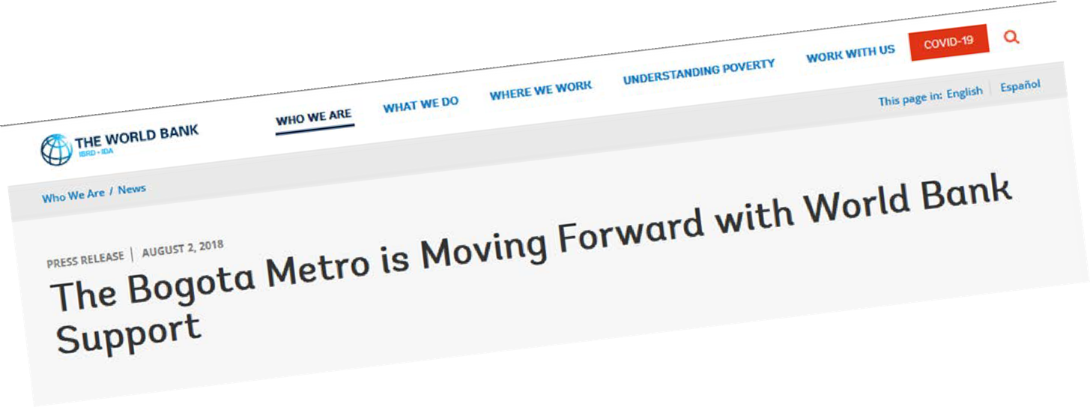
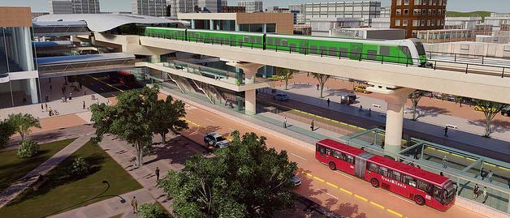
EXAMPLE: Metro, Bogotá, Colombia
- World Bank, 2019
Notes:
Another example is World Bank (IBRD) support for the development of a metro system in Bogota, Colombia.
In 2019, the World Bank approved its first loan of $70 million for the project which will support initial construction works of the viaduct, audits and technical studies for this project.
The borrower is the Bogota Metro Company and the project is supported by several other IFIs in a co-financing arrangement.
The European Investment Bank (EIB) is lending $53 million and the Inter-American Development Bank (IDB) $73 million which brings the total initial loan to $196 million.

Slide 10
IFC financed transport projects (ports)
10
Notes:
As of June 2020, the IFC has $2.4 billion committed in its transport investment portfolio. 35% of its transport investments are in ports.
>> See image: examples of 10 port related investments in countries including Turkey, India, Ghana, Myanmar and Egypt.
Source: IFC: A Leading Investor in Emerging Market Transportation
https://www.ifc.org/wps/wcm/connect/8d6413d7-f1cf-4414-a233-487d113e0a8f/Transportation-FINAL-10-19-20.pdf?MOD=AJPERES&CVID=nl61SUc

Slide 11
IFC financed transport projects (other)
11
Notes:
22% of IFC transport investments are in airports; 12% in roads; 7% in shipping; 7% in logistics; 4% in railways and 2% in urban transport.
>> See image: ten examples of investments in airports, roads, shipping, logistics and railways in countries including Serbia, Jordan, Greece, India and Senegal

Slide 12
ACTIVITY
Are IFIs on the agenda for your union?
Are IFIs active in your country?
Do they affect your members? And if so, how?
12

Slide 13
2. WHAT ARE IFI SAFEGUARDS AND
WHY DO THEY MATTER TO WORKERS

Slide 14
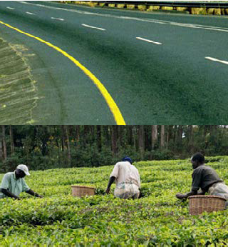
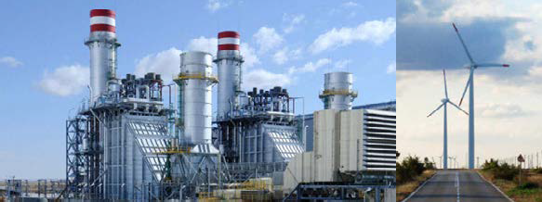
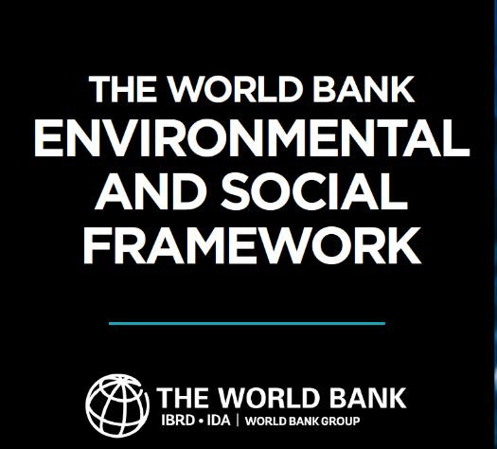
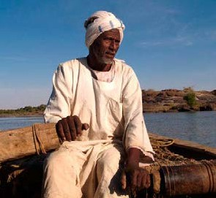
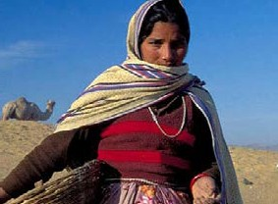
Each IFI has a set of ‘safeguards’ that stipulate the basic environmental and social protective standards which must be met by borrowers in order to receive IFI finance
Notes:
Despite the stated commitment of IFIs to reducing poverty and fostering sustainable development, their projects, as well as their policies, have often had extremely detrimental effects on people and the environment.
Over the course of several decades, pressure from trade unions and other civil society organisations has forced IFIs to adopt mandatory environmental and social protective standards or ‘safeguards’ which must be implemented by borrowers in order to receive IFI finance.
Safeguards cover a range of issues including the protection of biodiversity, the need to protect indigenous peoples and in some cases, the protection of labour and gender rights.
Safeguards become legally binding through their inclusion in loan agreements between IFIs and borrowers.
On paper this means that IFI safeguards are ‘enforceable’ in the sense that IFIs can suspend or withdraw funding in cases where safeguards are violated, and not adequately remedied by the borrower.
The image you can see is the World Bank’s ‘Environmental and Social Framework’ (ESF) which includes 10 safeguards (called Environmental and Social Standards).

Slide 15
10 ‘Environmental and Social Standards’ (safeguards) (mandatory requirements for borrower and projects)
'Environmental and Social Policy for Investment Project Financing' (for staff)
'Vision for Sustainable Development' (non-binding) Good Practice Notes (for staff) (non-binding)
Guidance Notes (for borrowers) (non-binding)
Notes:
Safeguards are generally included as part of an IFI’s wider ‘environmental and social framework’ or ‘sustainability framework’.
These frameworks bring together:
safeguards (which outline the obligations of borrowers);
mandatory policies and procedures which must be followed by IFI staff (including due diligence and monitoring requirements); as well as
other supporting documents such as ‘vision statements’ and non-mandatory guidance documents.
For example the World Bank’s ‘Environmental and Social Framework’ (ESF) – see image - includes:
its set of ten safeguards (‘Environmental and Social Standards’);
the ‘World Bank Environmental and Social Policy for Investment Project Financing’ which sets out mandatory requirements which must be followed by World Bank staff regarding the projects it funds; and
a non-binding ‘Vision for Sustainable Development’.
The World Bank also produces non-mandatory ‘Good Practice Notes’ for its staff on issues including gender and non-discrimination, as well as ‘Guidance Notes for Borrowers’ to guide the application of each of its ten safeguards.

Slide 16
DIFFERENT IFI
SAFEGUARD FRAMEWORKS
Bank | Environmental and social framework (ESF) / Safeguard policies | Dedicated Labour safeguard? | Dedicated gender safeguard?
World Bank | Environmental and Social Framework (ESF) (2016) | Yes | No
IFC | Sustainability Framework (2012) | Yes | No
AfDB | Integrated Safeguards System (2013) | Yes | No
ADB | Safeguard Policy Statement (2009) | No | No
AIIB | Environmental and Social Framework (2015, amended 2019) | No | No
EBRD | Environmental and Social Policy (ESP) (2019) | Yes | No
IDB | Environmental and Social Policy Framework (ESPF) (2020) | Yes | Yes
NDB | Environmental and Social Framework (2016) | No | No
Notes:
Each IFI has a different safeguard framework which includes different safeguards and different scopes of protection.
For example, the World Bank, IFC, EBRD and IDB each have eight to ten safeguards within their safeguard frameworks, including safeguards dedicated to protecting labour rights and in the case of the IDB, a dedicated gender equality safeguard, aimed at protecting women’s rights and gender equality.
The NDB and AIIB have much weaker and limited safeguard systems, each having only three safeguards and neither having dedicated to the protection of labour rights or gender equality.
The ITF Take Action Toolkit broadly covers the safeguard systems of these eight IFIs, while focusing on the safeguard systems of the World Bank and its private sector lending arm, the International Finance Corporation (IFC), given that these are the most influential IFIs globally and their safeguard policies have served as models for most other IFIs, as well as donors and the private sector.
Profiles of each IFI can be found in the guide that accompanies this presentation.

Slide 17
WHY DO IFI SAFEGUARDS MATTER TO
WOMEN TRANSPORT WORKERS AND THEIR TRADE UNIONS?
Notes:
IFIs impact the lives of many millions of transport workers across the world as a result of their investments in the transport sector
Given the gendered nature of the transport industry, IFI safeguards are far from perfect but they can provide an important tool and source of leverage for women transport workers and their trade unions to attempt to:
positively shape the design of transport projects in the interests of women workers and communities
demand improved working terms and conditions and employment opportunities for women in transport projects
protect the rights of women transport workers
hold IFIs and borrowers to account (whether they are governments or private employers) and demand a more gender responsive approach from IFIs and their borrowers

Slide 18
WHICH IFI SAFEGUARDS ARE MOST USEFUL TO TRANSPORT TRADE UNIONS?
‘General safeguards’ Economic displacement safeguards |  | Labour safeguards Gender-related safeguards
Notes:
As we have already seen each IFI has a set of safeguards that stipulate the basic protective standards to be met by the borrower to receive IFI financing.
These set out a number of protections.
However, we are just going to focus on the most useful safeguards from the perspective of trade unions aiming to support and advance the rights of women transport workers.
These are: (briefly - we’ll go cover these safeguards in more detail shortly):
What we’re calling ‘general safeguards’ – which are included in all IFI safeguard frameworks covered by this toolkit – and require borrowers:
to conduct environmental and social impact risk assessments;
to consult with project ‘stakeholders’ (i.e. those affected by or interested in a project);
to disclose relevant project information; and
to establish grievance mechanisms to allow those affected by a project to raise concerns and complaints with the borrower throughout the project’s implementation phase.
2) Economic displacement safeguards – which again are included in all IFI safeguard frameworks covered by this toolkit and require borrowers to avoid, and where avoidance is not possible, mitigate the risk of loss of jobs and livelihoods resulting from the implementation of an IFI-financed project.
3) Labour safeguards - which set out basic protections for workers employed by a borrower, including those who are employed indirectly through a contractor and – to a lesser extent - those engaged in a borrower’s supply chain. These safeguards are included in 5 out of the 8 IFIs covered by this toolkit
4) Gender-related safeguards – which set out basic protections for women and gender equality. In general women’s rights and gender equality are poorly protected by most IFI safeguard frameworks. In fact only one IFI - the Inter-American Development Bank (IDB) - has a safeguard specifically dedicated to the protection of gender equality
However, women’s and gender rights are often addressed in the sub-components of other IFI safeguards, which we’ll discuss further, including those addressing environmental and social risk assessments, stakeholder engagement, labour protections and economic displacement.

Slide 19
‘Project workers’ are workers:
involved in a borrower’s
employed directly by the borrower (‘direct workers’)
engaged through third parties
(‘contracted workers’)
primary supply chains (‘primary supply workers’ or ‘supply chain workers’)
Notes:
Out of the four categories of safeguard outlined, the question of which particular safeguards and subcomponents of safeguards will be of most use to women transport workers and their trade unions depends on the relationship between the borrower and the worker impacted by an IFI investment.
Transport workers are likely to fall into one of the two broad categories - what the World Bank calls ‘project workers’ and ‘project affected parties’
‘Project workers’ are workers who are:
employed directly by the borrower (‘direct workers’)
engaged through third parties (‘contracted workers’)
involved in a borrower’s primary supply chains (‘primary supply workers’ or ‘supply chain workers’).
Labour safeguards and their gender-related sub-components only apply to these workers.
The level of protection afforded to each category of project worker varies considerably, with ‘direct workers’ entitled to the most protection and ‘primary supply workers’ the least.
This guide borrows the term ‘project workers’ from the World Bank.
It should be noted that not all IFIs refer to such workers as ‘project workers’. For example the IFC does not use the term.
However, regardless of terminology, all IFIs with a labour safeguard define and restrict its applicability in a similar way.
Examples: project workers are employees of the company, for example Kenya Airways. If the loan relates to a specific site or subsidiary, such as Mersin International Port, then the covered workers are only those at the location, even if the borrower has other operations.

Slide 20
Project-affected parties
are people who are affected or likely to be affected by an IFI financed project
E.g. an informal urban transport worker (such as a minibus driver) whose job is threatened by the introduction of a new bus rapid transit (BRT) system
Notes:
‘Project-affected parties’ are people who are affected or likely to be affected by an IFI financed project. This includes workers whose livelihoods are directly impacted by an IFI-financed project
General safeguards, including the requirement for borrowers to conduct environmental and social impact assessments (ESIAs) and to consult with project ‘stakeholders’, apply to all ‘project-affected parties’ including workers who are economically displaced by a project.
Women affected by IFI-financed projects are afforded extra protections by gender-related subcomponents of general safeguards and economic displacement safeguards.
Note that IFIs use various terms to refer to ‘project-affected parties’, including ‘project-affected people’, ‘affected people’, and ‘affected communities’.

Slide 21
‘GENERAL SAFEGUARDS’
1
2
3
Environmental and social impact risk assessments (ESIAs)
Stakeholder Engagement/ Information Disclosure
Project-level Grievance Mechanisms
Notes:
Firstly we’re going to take a closer look at what we’re calling ‘general safeguards’ – which are included in all the IFI safeguard frameworks covered by this toolkit.
Included in this category is the requirement for borrowers to:
conduct environmental and social impact risk assessments (ESIAs);
consult with project ‘stakeholders’ (i.e. those affected by or interested in a project);
disclose relevant information related to the project; and to
establish grievance mechanisms to allow those affected by a project to raise concerns and complaints with the borrower throughout the project’s implementation phase

Slide 22
‘GENERAL SAFEGUARDS’
1
Environmental and social impact risk assessments (ESIAs)
Notes:
We’ll go through each of these in turn starting with ESIAs.
1) Before a loan is agreed by an IFI, borrowers must undertake an environmental and social impact assessment (ESIA) of the proposed project in order to identify, evaluate and manage its anticipated environmental and social risks and impacts throughout the lifetime of the project.
ESIA requirements are generally set out in the IFI’s first safeguard – for example the World Bank’s Environmental and Social Standard (ESS) 1 and IFC’s Performance Standard (PS) 1
Often undertaken by consultants, ESIAs (should) cover a wide range of issues related to an IFI’s safeguards – including assessing labour and gender specific risks (for IFIs with labour and/gender related safeguards) and the risk of ‘economic displacement’.
However, these kind of risks are often not adequately covered by ESIAs – hence the need for union interventions to highlight risks and impacts relevant to their members – as we’ll discuss shortly.
Based on the ESIA, and taking into account the IFI’s own due diligence findings as well as engagement with stakeholders, borrowers must then produce what the World Bank calls an ‘Environmental and Social Commitment Plan’ (ESCP).
The ESCP concretely outlines how anticipated risks and impacts will be managed and monitored by the borrower throughout the life of the project to ensure that the project’s outcomes are consistent with the objectives set out in the IFI’s safeguards.
Risks identified in an ESIA process could be historic poor labour practices on the part of a borrowing company, the risk of gender-based violence against company employees or the displacement of workers as a result of the implementation of an IFI-financed infrastructure project.
In order to be able to receive the IFI loan, the borrowing entity must outline how such risks would be managed and monitored – for example a company may commit to ensuring a satisfactory level of employment terms and conditions are included in the contracts of both its direct employees and those employed by its sub-contractors.
For transport workers who are economically displaced by an IFI-financed transport project, measures could include borrower commitments to supporting impacted workers gain employment in a new transport system or to access alternative sources of livelihood as part of the borrower’s “livelihood plan”, which we’ll discuss further when we look at Economic displacement safeguards

Slide 23
‘GENERAL SAFEGUARDS’
2
Stakeholder
Engagement
/ Information
Disclosure
Notes:
IFIs require that ‘stakeholders’ are consulted and ‘engaged’ in a project both as part of the initial ESIA and during the project implementation phase.
Stakeholders are defined by the World Bank (ESS 10, para. 5) as ‘individuals or groups who:
are affected or likely to be affected by the project (project-affected parties); and
may have an interest in the project (other interested parties)’.
Stakeholders may include ‘project workers’ (for IFIs with labour safeguards) or workers displaced by an IFI-financed project.
The IDB’s gender safeguard explicitly requires borrowers to ensure the meaningful participation of women as stakeholders.
However, as will be discussed further when we look at Gender-related safeguards, even IFI safeguard frameworks that lack dedicated gender safeguards often set out specific requirements for women to be consulted in the stakeholder consultation process.
It is essential that women workers and their trade unions are identified and subsequently consulted as project ‘stakeholders’ as this in principle requires their views and interests to be taken into account in the project design.
Stakeholder consultation with workers and trade unions allows labour and gender specific risks, for example historic anti-union behaviour or gender-based discrimination by the borrower, to be identified and for appropriate protective measures to be included in the borrower’s legally binding Environmental and Social Commitment Plan’ (ESCP).
It also creates a formal avenue for trade unions to demand that adequate project information is disclosed and appropriate labour and gender sensitive grievance mechanisms are put in place.
Unfortunately, women workers and their trade unions are all too rarely consulted as stakeholders in IFI projects and will often have to fight to get the recognition we deserve in the consultation process.

Slide 24
‘GENERAL SAFEGUARDS’
3
Project-level Grievance Mechanisms
Notes:
IFI Safeguards typically require the borrower to establish a grievance mechanism at the project level so that ‘project-affected parties’ can raise concerns and complaints with the borrower throughout the project’s implementation phase.
The World Bank sets out this requirement in its ESS10: Stakeholder Engagement and Information Disclosure safeguard and requires that the ‘[b]orrower will inform the project-affected parties about the grievance process in the course of its community engagement activities, and will make publicly available a record documenting the responses to all grievances received’ (ESS10, para. 27). The IFC sets out similar requirements in its PS1 safeguard.
IFIs with dedicated labour safeguards typically require that labour-specific grievance mechanisms are established for project workers, and in some cases, employers are mandated to implement special measures to facilitate the reporting of gender-based violence for project workers.

Slide 25
Those economically displaced by an IFI-financed project:
‘might include workers in public enterprises targeted for privatization, or workers whose jobs and activities could be drastically changed or entirely displaced’.
ITUC, (2019) The labour standards of the multilateral development banks: A trade union guide (p.32)
Notes:
Now we’ll look at economic displacement safeguards:
All IFIs covered by this toolkit require borrowers to avoid, and where avoidance is not possible, mitigate the risk of ‘economic displacement’ resulting from a project.
The issue of economic displacement is generally covered by safeguards addressing “involuntary resettlement”, a term that in some safeguards refers to both physical and economic displacement resulting directly from a project.
In cases where economic displacement is identified, borrowers are required to prepare a plan outlining measures aimed at allowing negatively impacted people to restore or improve their incomes or livelihoods.
The World Bank refers to such plans as “resettlement plans”, though different terms may be used in different projects.
The term “livelihood plan” may be used to refer to a plan that exclusively addresses economic displacement.
For ITF affiliates the problem of economic displacement has been particularly pronounced in cities where the introduction of IFI-financed bus rapid transit (BRT) systems has brought about job losses for workers in the incumbent informal urban transport industries that BRT systems seek to replace.
Such patterns of displacement can occur as a result of any transport restructuring/formalisation project, including the introduction of metro or light rail systems in cities, or the building of a new port.

Slide 26
LABOUR SAFEGUARDS
IFI | Dedicated labour safeguard?
World Bank | Environmental and Social Standard (ESS) 2: Labor and Working Conditions
IFC | Performance Standard (PS) 2: Labor and Working Conditions
AfDB | Operational Safeguard (OS) 5: Labour Conditions, Health and Safety
ADB | NO (but likely to adopt one following its 2020-2022 Safeguards Policy Review)
AIIB | NO
EBRD | Performance Requirement (PR) 2: Labour and Working Conditions
IDB | Environmental and Social Performance Standard (ESPS) 2: Labor and Working Conditions
NDB | NO
Notes:
Five out of the eight IFIs covered in this toolkit have dedicated ‘labour safeguards’ which set out basic protections for workers employed by a borrower, including those who are employed indirectly through a contactor and – to a lesser extent - those engaged in a borrower’s supply chain (see image).
All IFI labour safeguards are loosely based on the IFC’s PS2: Labour and Working Conditions, though there is some variation, especially with respect to gender provisions.
For example, the IDB is the only IFI to explicitly require that the implementation of its ESPS 2: Labour and Working Conditions safeguard ‘must also consider requirements related to gender equality’.

Slide 27
LABOUR SAFEGUARDS
1
2
3
child and forced labour
occupational health and safety
retrenchment
Notes:
With the exception of the World Bank, all IFI labour safeguards claim to be guided by the ILO’s Core Labour Standards.
The IADB’s ESPS 2 gender safeguard also includes a reference to ILO Convention 190 (2019), the first international convention dedicated to ending violence and harassment in the world of work.
Labour safeguards typically cover these seven key areas including:
1. child and forced labour: All labour safeguards explicitly prohibit child and forced labour.
2. occupational health and safety: All labour safeguards require that project workers are provided with a safe and healthy working environment.
Some IFIs have gender specific provisions of OHS requirements. For example, both the IFC and the IDB require that borrowers take into account ‘specific threats to women’ when designing measures to secure a safe and healthy workplace for project workers.
3. retrenchment: All labour safeguards except the World Bank’s ESS2 explicitly set out borrower obligations in cases of collective dismissals.
Borrowers are typically required to carry out an analysis of alternatives to retrenchment, and in cases where alternatives are not possible manage the retrenchment process in a manner that:
includes consultation with workers and their organisations,
mitigates adverse impacts on workers,
abides by the principle of non-discrimination, and
complies with the stipulations of national law and/or CBAs with regards to severance payments.
IFC, EBRD and IADB exclude contracted workers

Slide 28
LABOUR SAFEGUARDS
4
5
non- discrimination and equal opportunity
workers’ organisations
Notes:
4. workers’ organisations: In the majority of cases (the AfDB’s OS5 is an exception), IFI labour safeguards defer to the borrower’s national law with respect to workers’ rights to form and join trade unions and bargain collectively.
Labour safeguards therefore only generally protect the fundamental right to form trade unions and engage in collective bargaining in countries where these rights are already protected by national law.
In cases where the activity of trade unions is restricted by national law, borrowers are required only to allow workers to develop ‘alternative mechanisms’ to express grievances and protect their rights.
5. non-discrimination and equal opportunity: All labour safeguards state that the employment and treatment of project workers should abide by the principles of non-discrimination and equal opportunity and set out requirements such as:
Prohibiting discrimination on the part of the borrower in any aspect of the employment relationship including recruitment, hiring, wages, job assignment and promotion
Measures to be put in place to prevent and address harassment, intimidation, and/or exploitation.
The IFC, IDB, AfDB all state that such measures should be taken ‘especially in regard to women’ with the IDB (para. 16, fn. 80) specifically citing ILO C190 as providing ‘the international baseline for addressing these practices in the world of work’.
The EBRD (para. 14) explicitly states that appropriate measures must be taken to prevent and address ‘any form of gender-based violence’.
However, unfortunately, like provisions related to workers’ organisations, the majority of safeguard non-discrimination requirements (with the exception of the EBRD) defer to national law and only apply when they are not ‘inconsistent’ with national law, or when domestic law is ‘silent’ on the issue.
The IDB includes collection of ‘gender-disaggregated employment data to ensure non-discriminative hiring practices’ as a measure to implement its labour safeguard.

Slide 29
LABOUR SAFEGUARDS
6
7
labour grievance
mechanisms
working conditions and terms of employment
Notes:
6. labour grievance mechanisms: All labour safeguards mandate borrowers to establish a grievance mechanism for project workers and, where relevant, their organisations to raise workplace concerns.
Borrowers are required to inform workers of the grievance mechanism, make it easily accessible to them and to address concerns in a timely way and without retribution.
The EBRD and the IDB also require that special provisions be put in place for the special protection for reports of gender-based violence.
Even in the cases that IFIs do not specifically mention gender-based violence, women workers and their unions can push for such gender-sensitive provisions to be put in place within labour grievance mechanisms.
The ITUC have highlighted how: “Grievance mechanisms have become an area of focus in implementation of labour safeguards and can be one of the first changes to a borrower’s practices after receiving an investment” [ITUC, 2019, (p. 22)]
The are likely to be most effective when trade unions are able to support workers to raise their concerns. This is why the ITUC recommends trade unions demand establishment of ‘joint labour-management grievance committees’ in IFI projects
7. Working conditions and terms of employment: Labour safeguards typically require the borrower to ensure that working conditions and ‘labour management policies and procedures’ are aligned with the requirements of the safeguard (i.e. the provisions we’ve just looked at) and that workers are provided with clear information and documentation regarding the terms and conditions of their employment.
Examples of areas covered by working conditions and terms of employment include wages and benefits, hours of work and leave for maternity.
Several IFIs, including the IFC, explicitly state that in cases where the borrower already has a collective bargaining agreement with a trade union, such an agreement should continue to be respected.
The majority of labour safeguards also state that migrant workers must be employed on equivalent terms and conditions as non-migrant workers performing the same work.

Slide 30
DEDICATED LABOUR SAFEGUARD / TRADE UNION COMMUNICATION MECHANISMS
The IFC’s Labour Portal
The World Bank’s Grievance Redress Service
The EBRD’s Trade union communication mechanism
Notes:
While not explicitly stated in their labour safeguards, both the IFC and the EBRD have dedicated mechanisms designed to facilitate communication between trade unions and the relevant IFI regarding borrower compliance with labour safeguards, and in the case of the EBRD, with its Performance Requirement 4: Health, Safety and Security, which covers occupational health and safety.
These mechanisms (the IFC’s ‘labour portal’ and the EBRD’s ‘Trade union communication mechanism’) were established following pressure on both IFIs from trade unions, global union federations like the ITF and the ITUC to improve their application of labour safeguards.
The World Bank also has a ‘Grievance redress service’ which, while not exclusively for trade unions, provides an avenue for workers and trade unions to directly contact the World Bank, including with complaints related to violations of ESS2.
Further details on how to access these mechanisms can be found in the guide.

Slide 31
IFIs WITHOUT DEDICATED LABOUR SAFEGUARDS
Notes:
It’s worth saying that even IFIs without dedicated labour safeguards, do reference labour protections in other parts of their safeguard frameworks.
For example, both the AIIB and NDB mandate the implementation of health and safety measures to protect project workers, and the AIIB sets out a number of requirements for the management of labour in private sector projects (notably excluding public sector projects), including provisions on equal opportunity, non-discrimination and compliance with national law with respect to workers’ organisations.
The ADB mandates borrowers to provide workers with a safe and healthy working environment in its Safeguard Requirements 1: Environment. However, the majority of its labour-related requirements are found in different policy documents which require the ADB to ‘comply with internationally recognized core labor standards’ ‘in the design and formulation of its loans’.
It also has a core labour standards specialist position to facilitate union interaction with the ADB on labour issues, and is likely to adopt a dedicated labour safeguard in line with most other IFIs following its review of its safeguard policies, a process due to be complete in 2022.

Slide 32
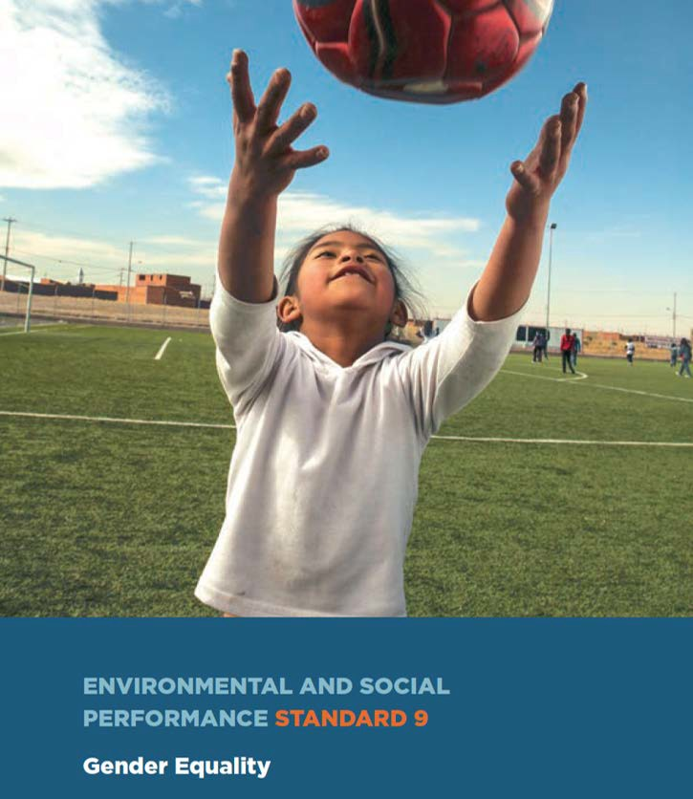
GENDER - RELATED SAFEGUARDS
Notes:
Women’s rights and gender equality are poorly protected by most IFI safeguard frameworks.
IFIs often bundle up the category of ‘women’ with other ‘vulnerable groups’ such as children and the elderly. This fails to meaningfully engage with gender-specific issues such as gender-based violence and the systemic exclusion of women (gender-based occupational segregation), both major problems in the transport industry.
Gender-related requirements are also often advisory rather than mandatory. In fact only one IFI - the Inter-American Development Bank (IDB) - has a safeguard specifically dedicated to the protection of gender equality (see image) – included in its new ESPF which came into force in late 2021.
However, women’s and gender rights are often covered in the sub-components of other IFI safeguards, including those addressing environmental and social impact assessments, stakeholder engagement, labour protections and economic displacement.
Despite the weakness of IFI safeguard gender provisions, unions can strategically use the gender related provisions that do exist to protect and further women transport workers rights – while also lobbying for gender-related provisions of IFI safeguards to be much stronger (which includes the demand for all IFIs to have a dedicated gender safeguard).

Slide 33
GENDER-RELATED PROVISIONS IN SAFEGUARDS
1
2
Environmental and social risk assessment
Stakeholder
consultation
Notes:
We are now going to look at the gender-related provisions that are included in safeguards
For example, ESIA safeguards may include the requirement for borrowers to assess and manage the gender-specific risks of a project.
The EBRD has the strongest provisions in this respect, stating that ‘[g]ender aspects…shall be considered throughout the assessment process’ (PR1, para. 12) as well as specifying that social assessments must be based on ‘social baseline data, including gender-disaggregated data, at an appropriate level of detail’ (PR1, para. 9).
The AfDB also claims that its staff carry out ‘an assessment of gender issues for every project and uses the findings as the basis for project design and compensation plans that lead to enhanced gender balance.’ (OS1, p. 26).
IFI stakeholder consultation safeguards often make specific reference to the requirement for women to be consulted.
For example, the IFC states that ‘[f]or projects with potentially significant adverse impacts on Affected Communities’ borrowers must ‘conduct an Informed Consultation and Participation (ICP) process’ which should:
i) ‘capture both men’s and women’s views, if necessary, through separate forums or engagements, and
ii) reflect men’s and women’s different concerns and priorities about impacts, mitigation mechanisms, and benefits, where appropriate’ (PS1, para. 31).

Slide 34
GENDER-RELATED PROVISIONS IN SAFEGUARDS
3
4
Economic displacement
Labour protections
Notes:
Economic displacement safeguards tend to contain specific gender components including requirements for borrowers to take into account gendered aspects of economic displacement (i.e. how men and women may be impacted differently by a project) and to put in place special measures to allow women to access alternative livelihood opportunities.
For example, the World Bank requires that borrowers ‘ensure that women’s perspectives are obtained and their interests factored into all aspects of resettlement planning and implementation’ (ESS 5, para. 18), while support for ‘alternative livelihoods’ of those economically displaced should, as appropriate, provide ‘special assistance to women, minorities or vulnerable groups who may be disadvantaged in securing alternative livelihoods (ESS 5, para. 27).
As already discussed, labour safeguards provide a number of protective provisions for women transport workers who are employed by a borrower, including those who are employed indirectly through a contractor and – to a lesser extent - those engaged in a borrower’s supply chain (‘project workers’).
Most gender-specific requirements of labour safeguards are included within sections on occupational health and safety (OHS) and non-discrimination and equal opportunity, as well as project level grievance mechanism provisions which – as discussed - in some cases mandate special measures to be put in place to protect those reporting instances of gender-based violence.

Slide 35
ACTIVITY
How can your union use IFI safeguards to support women transport workers?
What safeguards are most relevant/useful to your members?
Do you think it’s worth engaging with IFI safeguards? Are there limits to their usefulness?

Slide 36
3. ENGAGING WITH SAFEGUARDS

Slide 37
SAFEGUARDS Vs. REALITY
Notes:
Despite the existence of safeguards and IFI commitments to ‘sustainable economic development’ and poverty alleviation, the reality of many IFI investments can be quite different, often including labour rights abuses in IFI-financed companies, the destruction of informal livelihoods and the creation of poor-quality formal jobs in their place, and little attention paid to how investments impact gender equality.
For example, this image is of an Avianca airplane – Avianca, a Colombian airline company, which received a $50 million loan from the IFC in 2009 to renew its fleet – yet it had a long track record of anti-union behaviour.
So, what can we do as trade unions to make sure that existing safeguards are enforced and that IFI safeguard regimes more generally are improved – especially in the areas of protecting labour and gender rights?
One avenue we can use is taking complaints to independent accountability mechanisms (IAMs) of IFIs – which is what unions representing workers in Avianca did, supported by the ITF and ITUC.

Slide 38
INDEPENDENT ACCOUNTABILITY MECHANISMS (IAMs)
World Bank | Inspection Panel (IP)
IFC | Compliance Advisor Ombudsman (CAO)
AfDB | Independent Review Mechanism
ADB | Accountability Mechanism
AIIB | Project-affected People’s Mechanism
EBRD | Independent Project Accountability Mechanism (IPAM)
IDB | Independent Consultation and Investigation Mechanism (MICI)
NDB | None
Notes:
All but one of the IFIs covered in this guide have an ‘independent accountability mechanism’ (IAM) to which those whose rights or interests have been, or are likely to be, affected by a project supported by the IFI can submit a complaint (see table). This includes complaints related to violations of IFI safeguards.
While there is considerable variation between different IAMs in terms of eligibility criteria for complainants, the efficacy of their procedures and levels of independence from their associated IFIs, IAMs tend to undertake a similar set of functions:
Receive complaints
Determine the eligibility of complaints
In case of eligible complaints:
- resolve the dispute through mediation, fact-finding or other methods (sometimes called ‘problem solving’)
and/or
- investigate compliance with institution’s own procedures and safeguards (‘compliance review’)
Issue public reports covering the findings and recommendations (if any) of the investigation.
Trade unions have utilized IAMs to varying degrees of success to lodge complaints regarding borrower violations of labour safeguards as well as the failure of IFIs to comply with their own risk assessment and monitoring obligations.
While some complaints (or threats of complaint) have helped solve problems for workers at the workplace level, the effectiveness of such mechanisms is limited by the often extremely time-consuming nature of the complaints process as well as a lack of effective enforcement of safeguard compliance by IFIs.

Slide 39
AVIANCA AT THE IFC’S ‘COMPLIANCE ADVISOR OMBUDSMAN’ (CAO)
“…taking the complaint all the way to the World Bank allowed us to prove that it was the policy of those running Avianca to violate workers’ rights. This helped to ensure that those who took the reins at the company changed tack and now prefer the path of dialogue and consultation.”
Cristina Cadavid, ACAV, Colombia
Notes:
The case of Avianca
In 2011, the ITUC/Global Unions Washington Office submitted a complaint to the IFC’s CAO on behalf of ITF affiliates ACAV (Asociación Colombiana De Auxiliares De Vuelo) and ACDAC (Asociación Colombiana De Aviadores Civiles).
The unions were representing Avianca workers who had been subjected to sustained anti-union behaviour at the company, including the firing of union members, in clear violation of the IFC’s ‘Performance Standard 2’ (PS2) labour safeguard.
The complaint also outlined how the IFC had failed to adequately monitor and secure Avianca’s compliance with PS2 throughout the project cycle, including ignoring trade union warnings about the company’s history of serious labour rights violations before the loan was approved.
Following Avianca’s refusal to engage in a dispute resolution process with the union, the CAO embarked on a compliance investigation which, when its results were disclosed four years later in 2015, issued a scathing indictment of the IFC’s failure to secure Avianca’s compliance with the PS2 safeguard. While the CAO’s report was highly critical, including stating that the IFC had in fact erred in disbursing the loan to Avianca given its knowledge of the company’s poor labour rights record, its ability to bring about change in the company’s behaviour was severely limited because Avianca had already paid off its loan by the time the CAO’s findings were released. This meant that the IFC’s leverage over Avianca was profoundly weakened, and the company continued to engage in anti-union behaviour.
Despite the drawn-out period of time between the initial complaint being submitted and disclosure of the CAO’s report, as well as the lack of timely resolution to the Avianca workers’ concrete and immediate problems, the IAM process did prove strategically useful for workers at the company in the longer term. The CAO’s findings provided supportive evidence for what proved to be a successful national Supreme Court case against the company’s illegal labour practices.
Cristina Cadavid of the ACAV union said that Avianca’s court defeat allowed the workers and their unions to ‘successfully put an end to labour discrimination’ at the company, with the new company management now preferring the ‘path of dialogue and consultation with workers’. The case also led to positive changes within the IFC itself as the ITUC was able to pressure the IFC to improve its internal procedures in order to strengthen its ability to ensure borrower compliance with PS2.
“Indeed, after the CAO proceedings concluded, Avianca did not change its conduct. It was really only through the court judgment – which was non-appealable, as it was the highest and final court – that we successfully put an end to labour discrimination at that company.
Today, as there has been a complete change of management due to the change of ownership, this has opened the way to dialogue and we have been able to ensure bilateral consultation.
In conclusion, taking the complaint all the way to the World Bank allowed us to prove that it was the policy of those running Avianca to violate workers’ rights. This helped to ensure that those who took the reins at the company changed tack and now prefer the path of dialogue and consultation.”

Slide 40
4. THE PROJECT CYCLE

Slide 41
PROJECT CYCLE …
IFIs follow a set of procedures called a ‘Project Cycle’ for each project that is financed
Project identification
Preparation
/ Appraisal
Approval
/ Review
Implementation
/Monitoring
Completion
/ Evaluation
Notes:
Submitting complaints to IAMs are just one way that trade unions can try and protect transport worker rights within IFI investments.
Other options are available throughout an IFI’s ‘project cycle’.
IFIs follow a set of procedures called a ‘project cycle’ for each project financed by the IFI.
As will be discussed, there is a need for targeted union intervention at every stage of the cycle.
Project cycles can be composed of four to twelve stages, depending on the IFI.
Nonetheless, they all follow a general theme and can be broken down into five key stages:
Project identification
Preparation/Appraisal
Approval/Review
Implementation/Monitoring
Completion/Evaluation

Slide 42
PROJECT CYCLE …
1
Project identification
Notes:
If we look at each stage in a bit more detail:
Project identification
This is when proposals for projects are identified.
In the case of the World Bank, projects are identified by World Bank staff and government officials as part of a country’s broader Country Partnership Framework (CPF), a strategy document which sets out a program for World Bank Group activities and lending in a country over a three to five year period based on what are deemed to be national priorities.
In the case of the IFC, companies will proactively approach the IFC with an investment proposal. The IFC’s investment officers identify suitable proposals and following dialogue with the potential client, produce a brief description of the project to present to IFC senior management. Senior management then decide whether to authorise an appraisal of the project.

Slide 43
PROJECT CYCLE …
2
Preparation
/ Appraisal
Notes:
2. Preparation/Appraisal
After potential projects have passed an initial review, the borrower is required to undertake further project preparation, engaging in feasibility studies, stakeholder consultation and environment and social impact assessments (ESIAs), as mandated by the IFI’s safeguards. The IFI also undertakes its own environmental and social due diligence of proposed projects.
Based on the ESIA, and taking into account the IFI’s own due diligence findings as well as engagement with stakeholders, borrowers must then produce what the World Bank calls an ‘Environmental and Social Commitment Plan’ (ESCP). The ESCP concretely outlines how anticipated risks and impacts will be managed and monitored by the borrower throughout the life of the project to ensure that the project’s outcomes are consistent with the objectives set out in the IFI’s safeguards.
As part of the review of the environmental and social risks of a project, the IFI categorizes projects according to the magnitude of their anticipated risks and impacts. The resulting risk classification determines the level of IFI oversight of the project as well as requirements for information disclosure.

Slide 44
PROJECT CYCLE …
3
Approval
/ Review
Notes:
3. Approval/Review
Following negotiations between the IFI and borrower over the terms and conditions of the loan, the project is submitted to the IFI’s Board of Directors for consideration and approval. At this stage, legal agreements are finalised between IFI and borrower, including the borrower’s ‘Environmental and Social Commitment Plan’ (ESCP).

Slide 45
PROJECT CYCLE …
4
Implementation
/ Monitoring
Notes:
4. Implementation/Monitoring
The borrower implements the project while IFIs take on a supervisory role. IFIs monitor projects to keep track of development impacts and ensure borrower compliance with the conditions in the loan agreement, including compliance with safeguards and implementation of agreed action plans. Borrowers are required to regularly report on project activities.

Slide 46
PROJECT CYCLE …
5
Completion
/ Evaluation
Notes:
5. Completion/Evaluation
Following completion of a project, IFI staff produce reports compiling data and information from a project (for example see the World Bank’s Implementation Completion and Results Reports).
In some cases, projects are evaluated by an independent department in the IFI.
For example, the World Bank’s Independent Evaluation Group evaluates the performance of around one in every four World Bank projects.

Slide 47
INTERVENTIONS …
Different stages allow for different types of public intervention
that could affect the project, and advance labour and gender rights
The earlier stakeholders (e.g. unions, communities) intervene, the higher the possibility of being able to affect the course of the project and
Demand conditions that are beneficial
Ensure rights are protected
Notes:
The different stages of a project allow for different types of public intervention which could affect the project and advance labour and gender rights.
The earlier stakeholders (e.g. unions, communities etc.) are able to intervene in the project cycle, the higher the possibility of being able to:
affect the course of the project,
demand conditions beneficial to them, and
ensure that rights are protected.

Slide 48
PREPARATION
/APPRAISAL
IDENTIFICATION
Access to information
Impact analysis by union(s) (e.g. labour impact assessment)
Propose revisions
Participation in consultation
Influence T&Cs
Inform bank of anti-union acts
Develop critique, alternatives
Notes:
So, if we look again at the project cycle:
The early stages (identification / preparation / appraisal) of a project triggers a full range of assessments relating to the technical, financial, social and environmental aspects of the project.
This stage offers the best opportunity to impact the project.
If there is a strong labour movement, unions may be able to influence decision-making around whether the project is considered and propose revisions.
For example, to ensure that current workers will not be adversely affected and that there is maximum protection for workers unions could carry out their own impact analysis focusing on labour and gender issues. The ITF has supported affiliates do this in cities like Nairobi and Dakar – where IFI-financed BRT systems threaten the livelihoods of informal transport workers (see Labour Impact Assessments).
There is also an opportunity to lobby for gender aspects (e.g. women’s employment) to be integrated into a project’s design – for example concrete commitments to levels of women’s employment.
Unions and other stakeholders must ensure they can participate in the ‘stakeholder consultation’ process in order to influence the terms and conditions of the loan and inform the bank of any anti-union activities by the borrower or other groups who will be implementing the project (such as contractors).

Slide 49
APPROVAL
/REVIEW
Lobby IFI Board of Directors to not
approve or to modify project
Notes:
Later in the project cycle, it becomes more difficult to influence or shape what the project should look like.
Unions should try and raise concerns before board approval because this is when they have most leverage to stop or substantially change a project before a project is approved by an IFI’s Board of Directors (i.e. before loan conditions have been agreed between IFI and borrower, and before the loan has been disbursed).
In the event that trade unions are opposed to a project presented to the board, or still demand that significant changes are made to its design, it may be possible to lobby an IFI’s Board of Directors.
The ITF can support this process.

Slide 50
IMPLEMENTATION
/MONITORING
Investigate companies bidding for contracts
Inform bank of unfair labour practices
Update impact analysis
Lobby borrower to promote
good practice
Notes:
Monitoring safeguard compliance during project implementation is considered one of the weakest links in the chain of IFI safeguard regimes.
Unions have a crucial role to play in:
Investigating companies bidding to implement the project and informing IFIs if bidding companies have a poor record in terms of labour/gender rights.
Monitoring borrower and contractor compliance with safeguards and agreements or ‘action plans’ made in the (ESCP) - unions may choose to elect designated trade union ‘compliance monitors’ to help undertake this task.
Collect detailed information and worker testimonies related to violations. It can be useful to combine complaints with proposals for how the issue can be resolved, e.g. the reinstatement of dismissed workers, the recognition of a union or improved compliance monitoring on behalf of the IFI. The ITF can support the submission of such complaints at both the level of project level grievance mechanisms and IAMs.
Collect detailed information and worker testimonies related to safeguard compliance ‘good practice’.

Slide 51
EVALUATION
Alternative evaluation report
Notes:
In the evaluation stage unions can:
Collect data, workers’ testimonies and produce independent evaluation reports (as an alternative to IFI produced evaluations).
Share this experience with other unions and allies.
Use independent evaluation reports to both inform strategic union engagement with IFIs in the future as well as highlighting recurrent problems with borrowers and contractors as well as gaps and weaknesses in IFI safeguard systems.

Slide 52
Union interventions in the project cycle – KEY POINTS
Keep track of IFI activity in your country sector
Intervene early in the project cycle
Build Alliances
Demand the implementation of existing safeguards
Monitor compliance with safeguards and bring complaints in cases of violations
Evaluate IFI projects and share experiences
Access support from the ITF and the ITUC
Notes:
1) Keep track of IFI activity in your country sector. Keeping track of IFI activity in your country/sector allows unions to intervene early in the project cycle. This can be done in a number of ways including regularly checking IFI project disclosure webpages and signing up to the ITF EBRD/IFC mailing list to receive monthly emails containing early transport project disclosures from the IFC and EBRD.
2) Intervene early in the project cycle. It is crucial for trade unions to intervene at an early stage in the project cycle in order to influence the project’s design and make sure that labour and gender-related risks and impacts, as well as those associated with economic displacement, are – where relevant - recognised and appropriate protective and proactive measures are put in place by the borrower. When borrowers are governments or public bodies, this could involve lobbying political targets with influence over a project’s design such as parliamentarians, ministers and civil servants.
3) Build alliances. IFI financed projects can impact a huge a range of people and therefore provide opportunities to build powerful movements capable of positively shaping a project’s design and implementation in the interests of workers and communities. Such movements may be composed of workers from different sectors as well as other affected parties such as transport service users. For example, an urban transport restructuring project like BRT not only affects informal transport workers, but also street vendors as well as the passengers themselves, while its ‘project workers’ will include not only BRT transport workers but also the construction workers employed to build the BRT infrastructure and ‘core’ supply chain workers.
It is also important to remember that IFIs are – for the most part – lending out public money ultimately derived from the contributions of tax-payers across the world. The demand that public money should be spent on genuinely publically beneficial projects, and be subject to democratic processes of transparency and accountability, is a powerful and unifying rallying call.
4) Demand the implementation of existing safeguards. The existence of IFI safeguards on paper does not guarantee that they will be implemented in practice. Trade unions have a crucial role to play in making sure that IFI labour, gender and economic displacement related safeguards are, as appropriate, are applied and implemented in practice.
5) Monitor compliance with safeguards and bring complaints in cases of violations. Safeguard compliance monitoring on the part of IFIs, and of borrowers in relation to their contractors, is notoriously weak. Trade unions have a key role to play in monitoring borrower and contractor compliance with relevant safeguards, documenting violations and supporting worker complaints to grievance mechanisms, including project level grievance mechanisms and independent accountability mechanisms (IAMs).
6) Evaluate IFI projects and share experiences. Unions, their GUFs and the ITUC have an important role to play in collecting information and workers’ testimonies from IFI projects to both inform strategic union engagement with IFIs in the future as well as highlighting recurrent problems with borrowers and contractors as well as gaps and weaknesses in IFI safeguard systems.
7) Access support from the ITF and the ITUC. The ITF and ITUC have many years of experience in both challenging and strategically engaging with IFIs, for example through supporting unions bring complaints to IAMs and more recently commissioning labour impact assessments to highlight the negative livelihood impacts of IFI-financed BRT systems (see details at the end).

Slide 53
Our priorities
Strengthen women’s employment and end
occupational gender segregation
Promote decent work
End violence against women transport workers
Women in decision-making/negotiating teams
Trade unions as stakeholders
Worker-led formalisation
Stronger IFI safeguards
Notes:
1) Strengthen women’s employment and end occupational gender segregation: IFI financed companies and projects should promote women’s employment. In the highly gender-segregated transport industry this requires a proactive package of measures to be implemented, such as commitments to minimum levels of female employment in transport systems as well as the provision of training opportunities to ensure that women can access to new jobs when transport infrastructure is introduced or upgraded.
2) Promote decent work: IFI financed companies and projects should promote decent work. This requires terms and conditions that address decent work and labour rights to be included in contracts with employers, including contracted operating companies and sub-contractors.
3) End violence against women transport workers: All IFI projects should incorporate measures to prevent gender-based violence (GBV) in line with the requirements of ILO Convention190.
4) Women in decision-making/negotiating teams: Women workers and their representative organisations must be consulted as stakeholders and their views taken into account in project design.
5) Trade unions as stakeholders: Trade unions should be recognised as stakeholders in all IFI-financed transport projects, whether representing workers employed directly or indirectly by borrowers or workers economically displaced by IFI projects. Women workers must be fairly represented in their trade unions, including in leadership positions and on negotiating teams.
6) Worker-led formalisation: IFI-financed projects that economically displace informal transport workers should put in place measures to facilitate a just and worker-led transition from informal to decent formal work for women and men workers
7) Stronger IFI safeguards: IFI safeguards exist due to decades of pressure from trade unions and other civil society organisations. Trade unions and their allies at local, national and international level must continue to push for better and stronger safeguards, especially in the area of labour and gender, including demanding that all IFIs adopt dedicated gender safeguards, undertake gender impact assessments for all projects and incorporate the provisions of ILO C190 into their labour safeguards.

Slide 54
ACTIVITY
1. EXERCISE - design a strategic union engagement plan to respond to either of the following situations, focusing on how your union and the ITF can most effectively support women transport workers at each stage of the IFI project cycle
i) The World Bank is considering financing the introduction of a BRT system in the capital city of your country. Your union represents informal transport workers who are likely to be displaced by the implementation of the new BRT system
ii) The IFC is considering issuing a loan to your employer – a private transport company. Your union represents workers directly employed by the company and by some of its sub-contractors. Your members have had lots of problems with the company/its sub-contractors – including experiencing discriminatory hiring practices and anti-union behaviour
Notes:
Note for facilitator: activities and exercises will really depend on the audience of the presentation – if we’re talking to informal worker unions then the questions need to be tailored towards general/economic displacement safeguards, if the audience is unions representing employees, then again the activities/questions need to be changed accordingly (e.g. are your members direct or indirect employees? Etc.)

Slide 55
5. RESOURCES AND SUPPORT

Slide 56
FURTHER INFORMATION
For more information on how affiliates can access ITF support related to engaging with IFI safeguards contact: women@itf.org.uk
Sign-up to the ITF EBRD/IFC mailing list to receive monthly emails containing early transport project disclosures from the IFC and EBRD: women@itf.org.uk
All resources can be found at: www.itfglobal.org
Notes:
Request to facilitator: Please contact the ITF women’s department (women@itf.org.uk) to update on how the presentation was used, any feedback etc.

